Slide 1
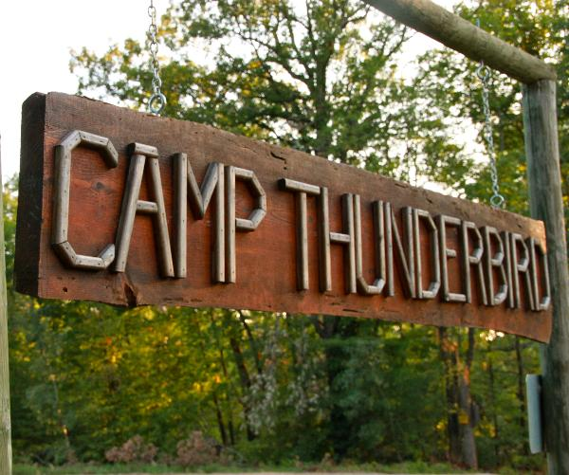
What’s Coming Up in 5th Grade?

Slide 2
What’s Coming Up in Language Arts?
2nd Quarter 3rd Quarter 4th Quarter
11/1-1/18 1/23-3/28 4/1-6/7
Expository Non-Fiction Fiction (Folklore, Fables) Review/Test Prep
Poetry Poetry, Plays Argumentative Essays
Non-Fiction Picture Books Imaginative Narrative
Word Work: continue to increase vocabulary through the study of Greek and Latin roots
5th Grade Standards
reference the text to answer inferential questions about character traits, motives and feelings
use context clues to determine the meaning of unfamiliar words
state the main idea or theme of a given text
state the relationship between events, ideas, and characters
use information gained from text features to answer questions
produce writing in which the development and organization are appropriate to task and purpose

Slide 3
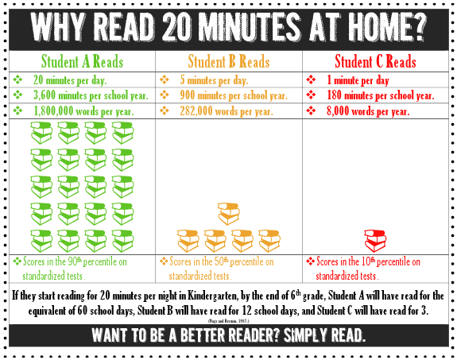

Slide 4
What’s Coming Up in Math?
2nd Quarter 3rd Quarter 4th Quarter
11/1-1/18 1/23-3/28 4/1-6/7
Decimals Numeric Expressions Geometry
Fractions Order of Operations
Volume Measurement
5th grade math consists of a individual work, group work and partner work. We share strategies and ideas throughout all lessons. We have warm-ups and exit tickets daily to reinforce what we have already learned.
5th Grade Standards
Place Value with Whole Numbers and Decimals Measurement
Multiplication and Division Geometry
Operations with Decimals Evaluating Expressions
Adding and Subtracting Fractions Measurement
Multiplying and Dividing Fractions Data

Slide 5
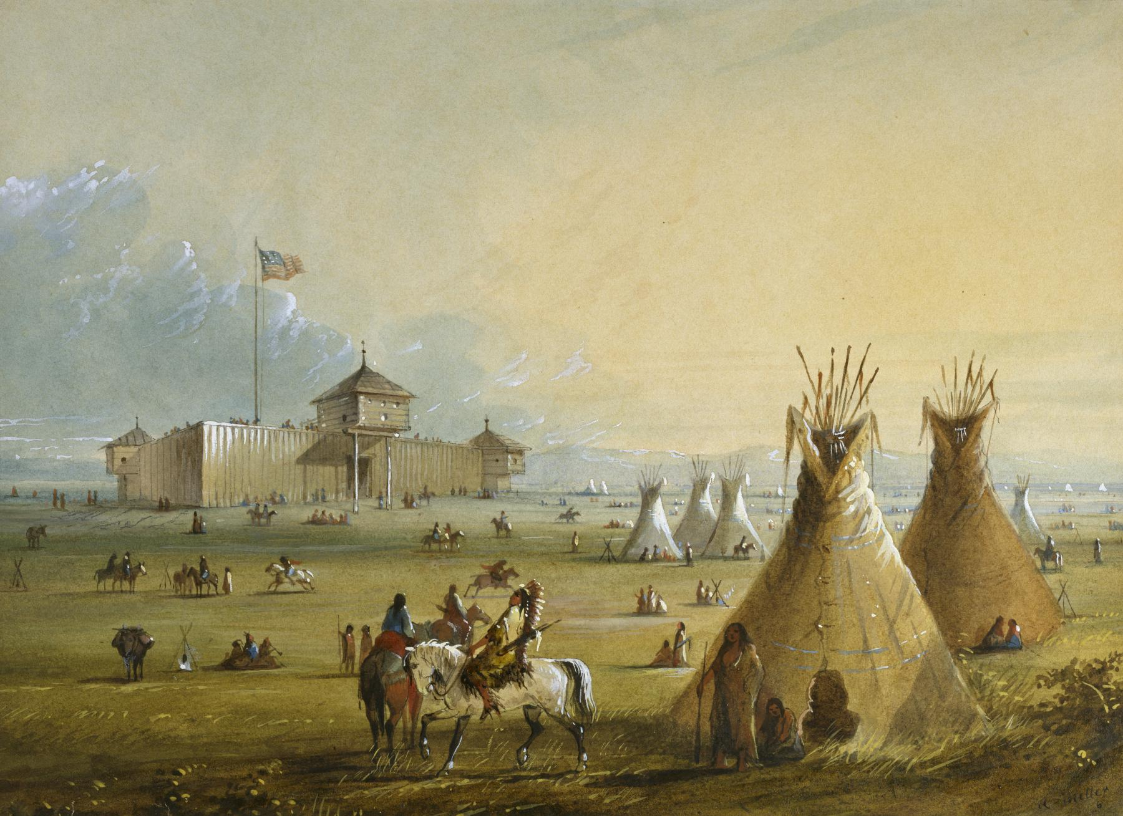
What’s Coming Up in Social Studies?
Social Studies classes are taught using a variety of formats, including mini-lecture, read alouds, centers, and inquiry groups.
There are 4 main units: Native Americans, European Explorers,
American Revolution and the Civil War
Our goal is that students master the following objectives:
5th Grade Objectives:
use context clues to determine the meaning of unfamiliar words
explain an author’s point of view and how the author
supports this view with reasons and evidence
compare and contrast different regions and cultures
access needed information using appropriate resources
explain the contributions and impact of human interactions on modern day America

Slide 6
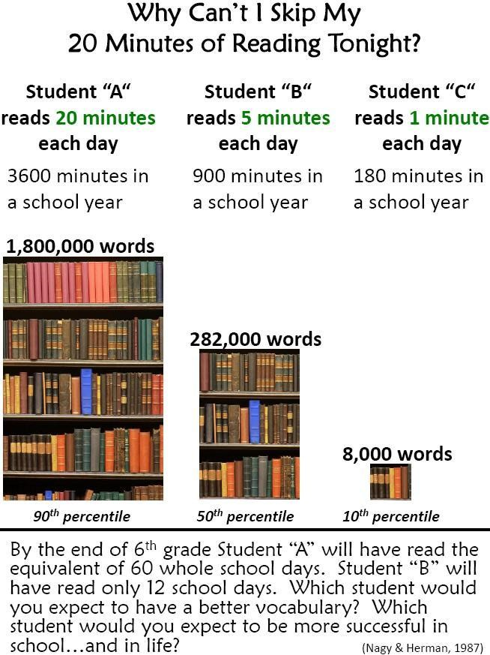

Slide 7
What’s Coming Up in Science?
2nd Quarter 3rd Quarter 4th Quarter
11/1-1/18 1/23-3/28 4/1-6/7
Matter Earth Systems Living Organisms
Energy Ecosystems Evolution & Genetics
Earth Systems Review/Test Prep
Science classes are taught using a variety of formats including: mini-lecture, class discussions, experiments, stations, and inquiry groups. Our goal is that students master the following objectives:
5th Grade Standards
Understand force, motion and the relationship between them
Understand the interactions of matter and energy and the changes that occur
Explain how the properties of some materials change as a result of heating and cooling
Understand weather patterns and phenomena, making connections to the weather
Understand how structures and systems of organisms (to include the human body) perform functions necessary for life
Understand the interdependence of plants and animals with their ecosystem
Understand why organisms differ from or are similar to their parents based on characteristics

Slide 8
Caring School Community (CSC) Lessons
As a pilot school for the Caring School Community lessons in CMS, fifth graders will be participating in a variety of lessons with the following objectives:
increase in student's safety and sense of well-being
Increase in student performance through improved self-management and interpersonal skills

Slide 9
Other News in 5th Grade!
Camp Thunderbird- Monday, October 8th
Payment & Forms due Monday, October 1st
Chocolate Sale – Permission Forms go home Thursday, September 27th.
Asheville – April 26, 2019
Carowinds – June 2019

